Slide 1



Dsa Project

Slide 2


Social media features application Useing Linkedlist
Prepared by:
sofikul sk ,Manas sukla and Uzair Rajpoot

Slide 3
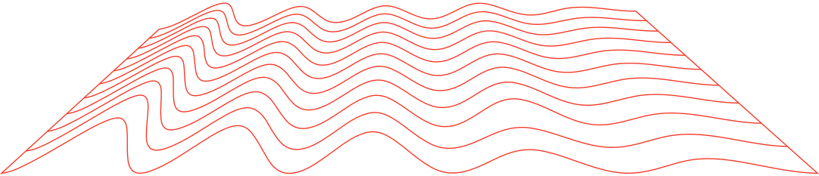
CONTENT
1 | About The porject
2 | Problem Statement
3 | Data Structures Used And Why
4 | Core Features Implemented
1 | Challenges and Solutions
2 | Conclusion
3 | References
4 | Contact Information
5 | Implementation Details
6 | Example Use Case
 | Core Features Implemented
 | Core Features Implemented

Slide 4



ABOUT THE PROJECT
Here's a draft for the "About the Project" section of your PowerPoint presentation:
About the Project
This project is a simulation of a social media platform, modeled after popular applications like Instagram and Facebook. The goal of this project is to replicate the basic functionalities of a social media network using data structures, specifically linked lists, in C++.

Slide 5

PROBLEM STATEMENT
The project addresses the challenge of simulating key features of social media platforms like Instagram and Facebook, such as user management, friendships, and posts. The goal is to demonstrate how linked lists in C++ can effectively model and manage the dynamic relationships and operations within a social network, such as adding users, connecting friends, and sharing posts. This simulation provides a foundational understanding of the data structures that underpin real-world social media platforms.

Slide 6





DATA STRUCTURE USED
Data Structures:
linked list is a linear data structure that stores data in nodes, which are individual objects that contain both data and a reference to the next node in the list

Slide 7

WHY LINKED LISTS?
1.Dynamic Memory Allocation: Linked lists allow for efficient use of memory, as nodes are created only when needed.
2.Flexible Structure: Nodes can be easily added or removed, making it ideal for simulating the dynamic nature of social networks.
3.Ease of Traversal: Linked lists make it simple to traverse connections, which is essential for operations like finding mutual friends.

Slide 8



Core Features Implemented
User Management:
Add User: Allows new users to be added to the social network.
Remove User: Enables deletion of users from the network (if implemented).

Slide 9

Friendship Management:
Add Friend: Connects two users as friends by linking their profiles.
Remove Friend: Disconnects two users, removing the friendship link.
Show Friends: Displays all friends of a user.
Show Mutual Friends: Identifies and displays mutual friends between two users.

Slide 10
3.Post Management:
Create Post: Users can create posts that are linked to their profiles.
View Posts: Allows users to view their posts and those of their friends.
4.Network Traversal:
Search User: Enables searching for users within the network.
Display Network: Provides a visual representation of the entire social network and its connections.

Slide 11
Implementation Details
Data Structure Design:
Linked Lists for Users and Friends
Each user in the social network is represented as a node in a singly linked list.
Each user node contains pointers to another linked list of friends (friend list) and a linked list of posts (post list).
This design allows for dynamic addition and removal of users, friends, and posts, providing flexibility and efficiency.

Slide 12
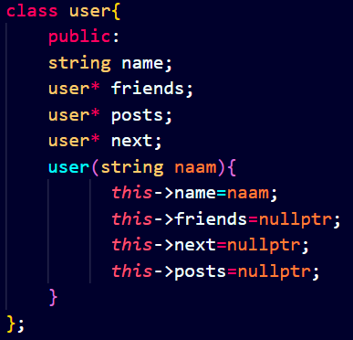
Key Methods:
addUser(string name):
Logic: Creates a new user node and adds it to the end of the linked list. This method traverses the list to find the last user and appends the new user.

Slide 13
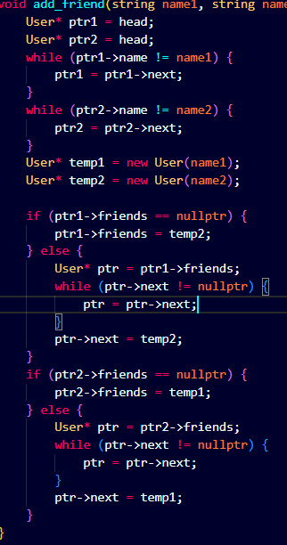
Key Methods:
addFriend(string name1, string name2):
Logic: Locates the user nodes for both name1 and name2 by traversing the linked list. It then adds each user to the other’s friend list.

Slide 14
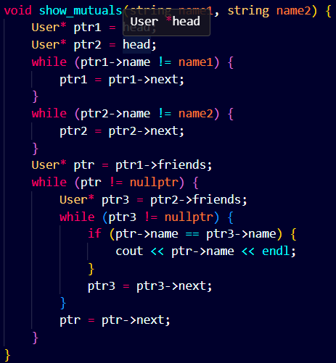
Key Methods:
showMutuals(string name1, string name2):
Logic: Compares the friend lists of two users to find common friends. This is done by traversing the friend lists of both users and checking for matches.

Slide 15
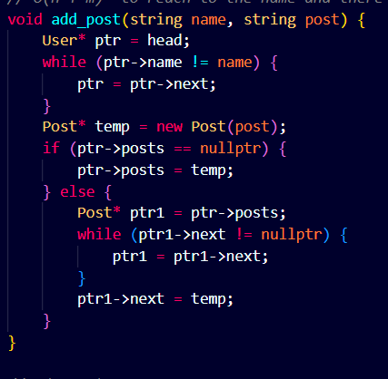
Key Methods:
Posts
Logic:
When a user creates a post, a new Post node is created.
This new post is then added to the user's linked list of posts.
The new post is typically added to the end of the list to maintain chronological order.

Slide 16
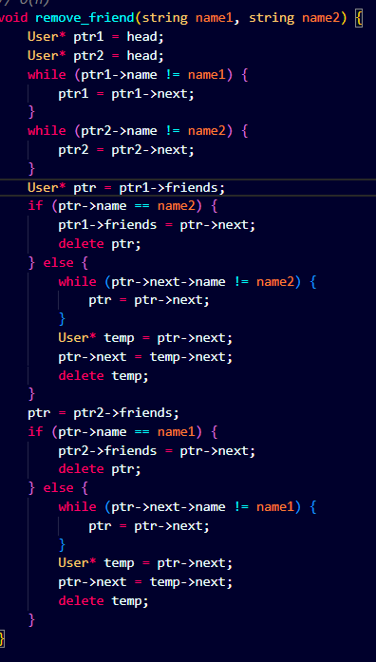
Key Methods:
Remove friends
Logic:
To remove a friend, the program needs to traverse the user's friend list to find the friend to be removed.
Once found, the friend is removed by adjusting the pointers of the surrounding nodes to skip over the removed friend.
The process is repeated for both users involved in the friendship to ensure the relationship is removed from both sides.

Slide 17
Examlple use caces
case1:No user present
user
user
Temp
head=
Temp

Slide 18
Examlple use caces
case2:Already user present
ptr
user1
user2
user3
user3
null
head

Slide 19
ptr
user1
user2
user3
user3
null
head

Slide 20
ptr
user1
user2
user3
user3
null
head

Slide 21
ptr
user1
user2
user3
user3
null
head

Slide 22
ptr
user1
user2
user3
user3
null
head
user
Temp

Slide 23
user1
user2
user3
user3
user
null
head

Slide 24



HOW CAN WE ADD FRIENDS

Slide 25
Adding friends
ptr1
ptr2
Rajib
User2
Soma
Naaz
null
head
Making Rajib and soma friend

Slide 26
Adding friends
ptr1
ptr2
Rajib
User2
Soma
Naaz
null
head
Making Rajib and soma friend

Slide 27
Adding friends
ptr1
ptr2
Rajib
User2
Soma
Naaz
null
head
Making Rajib and soma friend

Slide 28
Adding friends
ptr1
ptr2
Rajib
User2
Soma
Naaz
head
Making Rajib and soma friend

Slide 29
null
null
friends
Rajib
User2
Soma
Naaz
null
head
Soma
Rajib
temp2
temp1

Slide 30
null
null
Soma
Rajib
Rajib
User2
Soma
Naaz
null
head

Slide 31
null
null
Soma
Rajib
Rajib
User2
Soma
Naaz
null
head
Making Rajib and Naaz friend

Slide 32
rajib
Naaz
null
null
temp1
temp2
soma
rajib
null
rajib
user2
soma
Naaz
null
ptr1
ptr2

Slide 33
rajib
Naaz
null
null
temp1
temp2
soma
rajib
null
rajib
user2
soma
Naaz
null
ptr1
ptr2

Slide 34
rajib
Naaz
null
null
temp1
temp2
soma
rajib
null
rajib
user2
soma
Naaz
null
ptr1
ptr2

Slide 35
rajib
Naaz
null
null
temp1
temp2
soma
rajib
null
rajib
user2
soma
Naaz
null
ptr1
ptr2

Slide 36
rajib
Naaz
null
null
temp1
temp2
soma
rajib
null
rajib
user2
soma
Naaz
ptr
null
ptr1
ptr2

Slide 37
rajib
Naaz
null
null
temp1
temp2
soma
rajib
ptr
null
rajib
user2
soma
Naaz
null
ptr1
ptr2

Slide 38
null
Naaz
temp2
null
null
soma
rajib
rajib
temp1
rajib
user2
soma
Naaz
null
ptr1
ptr2

Slide 39


HOW CAN WE ADD FRIENDS

Slide 40
post
temp=
head
Rajib
User2
Soma
Naaz
ptr
Let’s create a post for Naaz

Slide 41
post
temp=
head
Rajib
User2
Soma
Naaz
null
ptr

Slide 42
post
temp=
head
Rajib
User2
Soma
Naaz
null
ptr

Slide 43
post
temp=
head
Rajib
User2
Soma
Naaz
null
ptr

Slide 44
post
temp=
null
head
posts
Rajib
User2
Soma
Naaz
null
ptr

Slide 45
post
head
posts
Rajib
User2
Soma
Naaz
null
ptr
ptr
posts
temp

Slide 46
null
post
head
posts
Rajib
User2
Soma
Naaz
null
ptr
ptr
posts
temp

Slide 47

how we can remove friends

Slide 48
Lets’s remove rajib from Naaz’s friends list
Logic:we will ittrate from the head to naaz firstand then from the Naaz pointer we will ittrate to Naaz’s friends and will go upto the friend which we want to delete ,after reaching before the node we want to delete we will assign the next of that pointer as null.

Slide 49
null
Naaz
null
null
soma
rajib
rajib
rajib
user2
soma
Naaz
null
ptr1

Slide 50
null
Naaz
null
null
soma
rajib
rajib
rajib
user2
soma
Naaz
null
ptr1

Slide 51
null
Naaz
null
null
soma
rajib
rajib
rajib
user2
soma
Naaz
null
ptr1

Slide 52
null
Naaz
null
null
soma
rajib
rajib
rajib
user2
soma
Naaz
null
ptr1

Slide 53
null
Naaz
null
null
soma
rajib
rajib
rajib
user2
soma
Naaz
null
ptr1

Slide 54
null
Naaz
null
null
soma
rajib
rajib
rajib
user2
soma
Naaz
null
ptr1

Slide 55
null
Naaz
null
null
soma
rajib
rajib
ptr
rajib
user2
soma
Naaz
null
ptr1

Slide 56
null
Naaz
null
null
soma
rajib
rajib
ptr
rajib
user2
soma
Naaz
null
ptr1

Slide 57
null
Naaz
null
null
null
soma
rajib
rajib
next
ptr
rajib
user2
soma
Naaz
null
ptr1

Slide 58
null
Naaz
null
soma
rajib
null
rajib
user2
soma
Naaz
null
ptr1

Slide 59
null
Naaz
null
soma
rajib
null
rajib
user2
soma
Naaz
null
ptr1

Slide 60

CHALLENGES AND SOLUTIONS

Slide 61



Challenge: Managing Dynamic Memory Efficiently
Implemented careful memory management by ensuring that every new allocation is paired with a corresponding delete when a node is no longer needed.
Used smart pointers or manual deletion in destructors to ensure that when a user is deleted, all associated posts and friends are also deleted.
Regularly tested the program with tools like Valgrind to check for memory leaks and ensure proper memory management.

Slide 62
Challenge: Handling Edge Cases in User Operations
Incorporated validation checks before performing operations. For example, before adding a new user, the system checks if the user already exists.
Added error handling mechanisms to gracefully handle cases where an operation can’t be completed (e.g., trying to remove a non-existent friend).
Implemented clear and informative error messages to guide the user on what went wrong and how to fix it.

Slide 63
Challenge: Ensuring Scalability
Considered alternative data structures like hash tables or balanced trees for certain operations if the network scales significantly. For example, a hash table could be used to quickly access users by name.
Focused on optimizing the existing linked list implementation by minimizing unnecessary traversals and ensuring that operations are as efficient as possible within the constraints of the linked list structure.

Slide 64
CONCLUSION
This project successfully simulates a social media platform using linked lists in C++, showcasing how fundamental data structures can be applied to real-world scenarios. By implementing core features such as user management, friendships, and post handling, the project demonstrates the power and flexibility of linked lists in managing dynamic and interconnected data. Through tackling challenges like memory management and ensuring consistency in user relationships, this project highlights the importance of efficient data structure design in building scalable and robust applications.

Slide 65
REFERENCES
Most of the implementation that we have done from the knowledge , that we have got from our DSA mentor sri. Deepak gour
GeeksforGeeks - Linked Lists in C++
URL: https://www.geeksforgeeks.org/data-structures/linked-list/

Slide 66
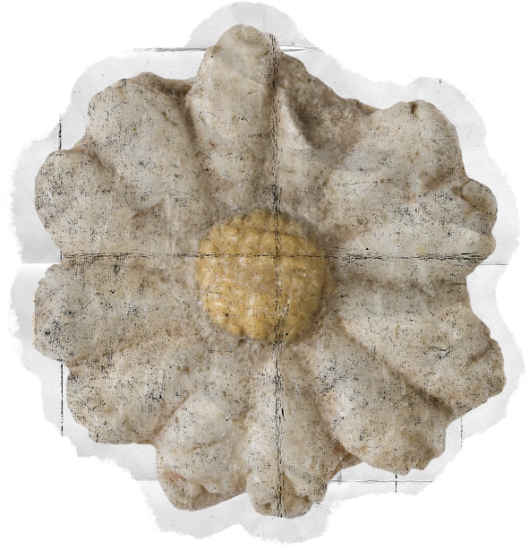
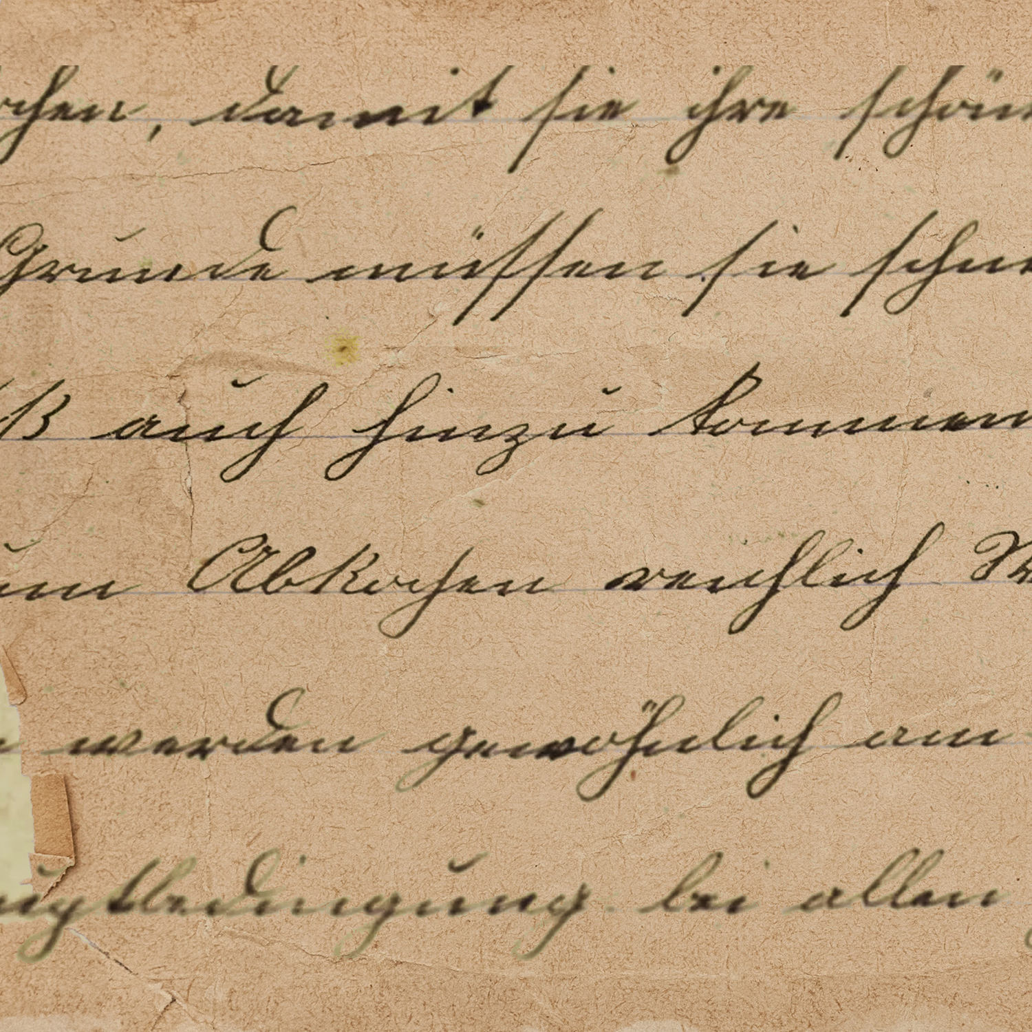




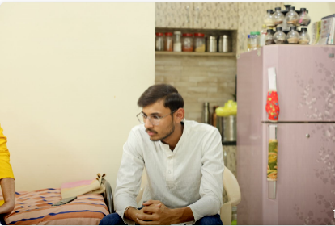

Team
Sofikul sk
Manas Shulkla
Md Uzair Rajput

